Slide 1


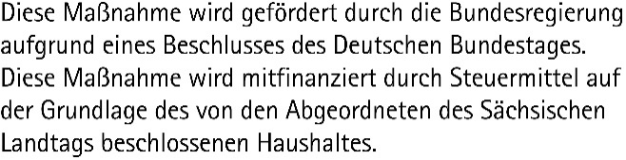
Data Science and AI for Medicine Training School
TRAINING: Python Basics
SPEAKER: Matthias Täschner

Slide 2
AGENDA
Programming Concepts
Python – Terms and Definitions
Execution of Python Code
Python – Virtual Environments
Python – Built-in types
Python – Conditions
Python – Loops

Slide 3
Programming Concepts
What is programming?
Use of programming language to implement software requirements as a computer program
Computer program is converted into machine code for execution (compiled or interpreted)
What is a programming language?
Tool for formulating algorithms and data structures
Formal language with syntax and semantics
Algorithm
Consists of instructions to solve a problem
Instructions consist of permitted patterns
Data Structure
Object to store and organize data in memory
Syntax
Formal set of rules for the use of instructions
“Grammar” of a programming language
Semantics
Actual meaning of the instructions

Slide 4

What is Python?
Universal high-level programming language, also often used for scripting
Released in 1994, recent stable version is 3.13
Goals: simplicity, clarity, extensibility
Few reserved keywords, reduced syntax
Extensive standard library, e.g., file handling, math, text processing, …
Easy integration of additional packages / libraries
Open Source, portable on multiple platforms
Extensively used in data science, data analysis, artificial intelligence
Easy management and use of additional packages and extensions
Built-in package manager “pip” with Python package index PyPI
Python distributions shipping Python + alternative package manager (e.g., “conda”) + virtual environments + preinstalled packages) – e.g., Miniconda, Anaconda
(TM) Trademark of the PSF https://www.python.org

Slide 5
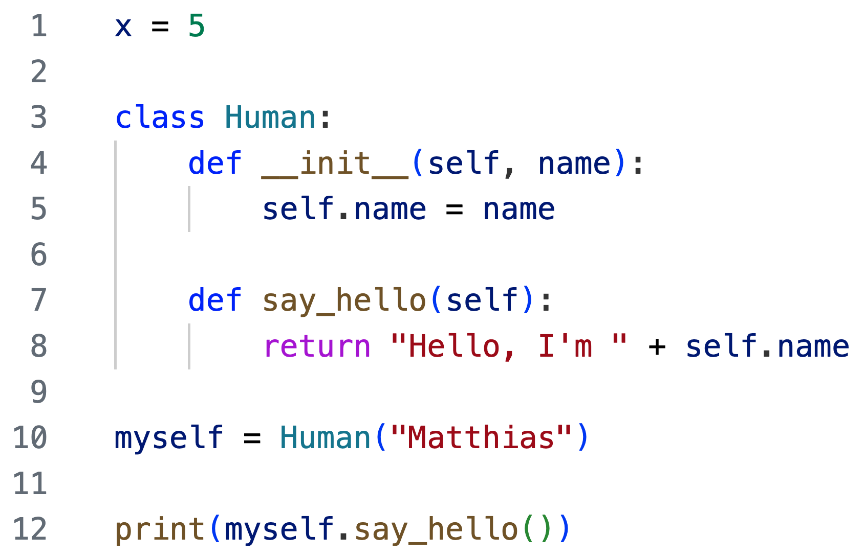
What is Python? Terms and definitions
Assignment
Variable name
Value of specific type
Variable Container for storing assigned data in memory, using a name for reference
Definition of custom object
Object
Complex structure which bundles data and methods to operate on the data
Everything in Python is an object
Instantiation and assignment
to variable
Method
Block of code tied to an object, usable via dot-Operator (”method is mine”)
Use of object’s method

Slide 6
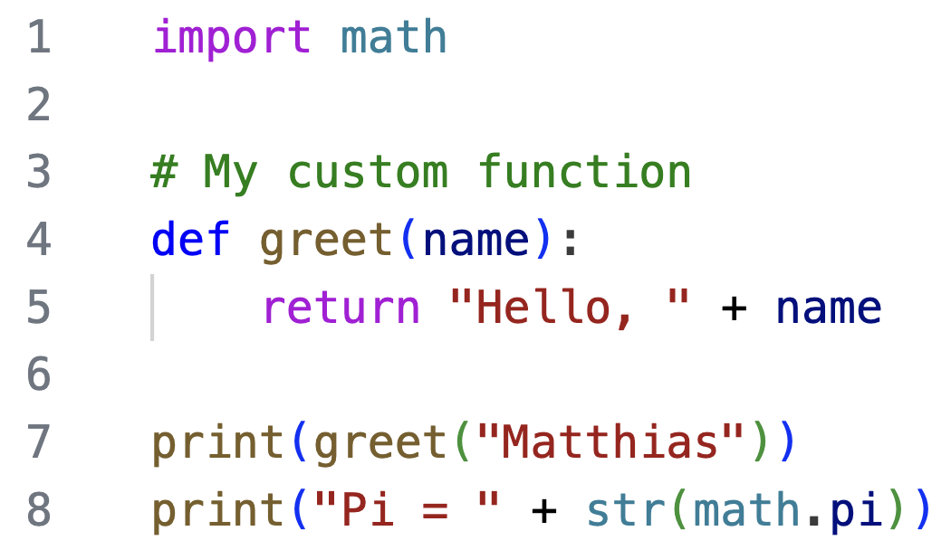
What is Python? Terms and definitions
Import module for additional functionality
Comment, not interpreted
Function
Independent block of reusable code for a specific task
(“function is free”)
Definition of custom function
Module
File containing Python code which can be imported into other Python code
Use of custom function
Comment
Lines in code not interpreted by Python, used for documentation,
starting with #
Use of built-in function
Use of built-in function
Use method from imported module

Slide 7
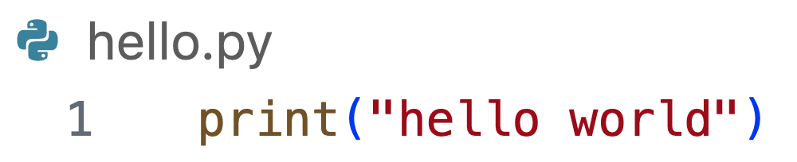
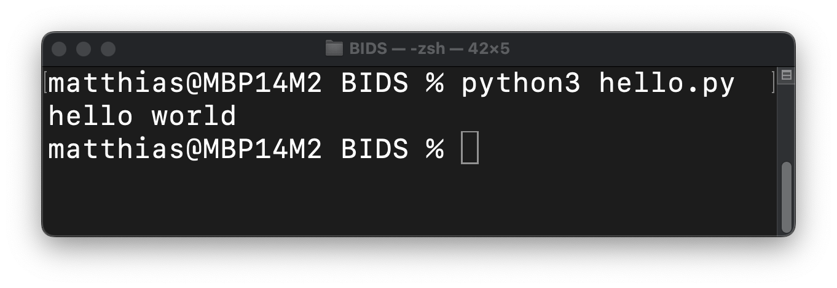
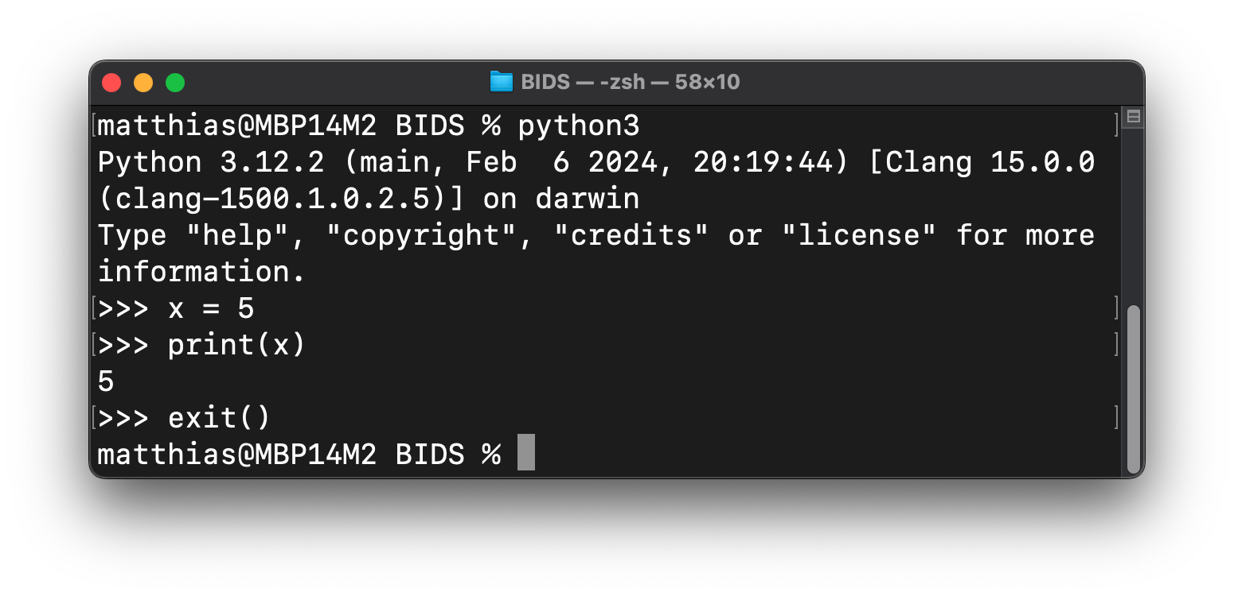
Execution of Python code
Execution via Python file
Save code in file with file extension “.py”
Execute file with installed Python
Interactive execution in terminal
Start interactive Python session
Enter and execute instructions line by line

Slide 8
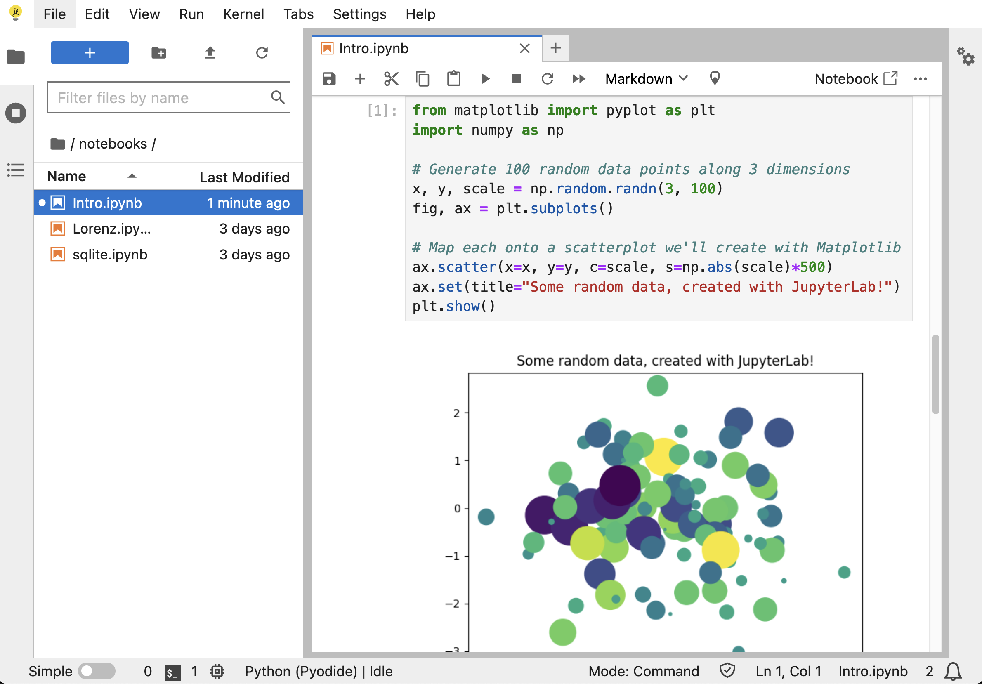
Execution of Python code
Interactive execution in Jupyter Notebook
Web-based interface with cells for
Executable Python code
Rich text for documentation
Rich output for text, images, plots
Jupyter Lab with
Jupyter notebook
File browser
Terminal access
Plugins
https://jupyter.org/try-jupyter/lab/index.html

Slide 9



Python – Virtual Environments
Python 2.7
Pandas 0.25.3
Python 3.13
Pandas 2.2.3

Slide 10
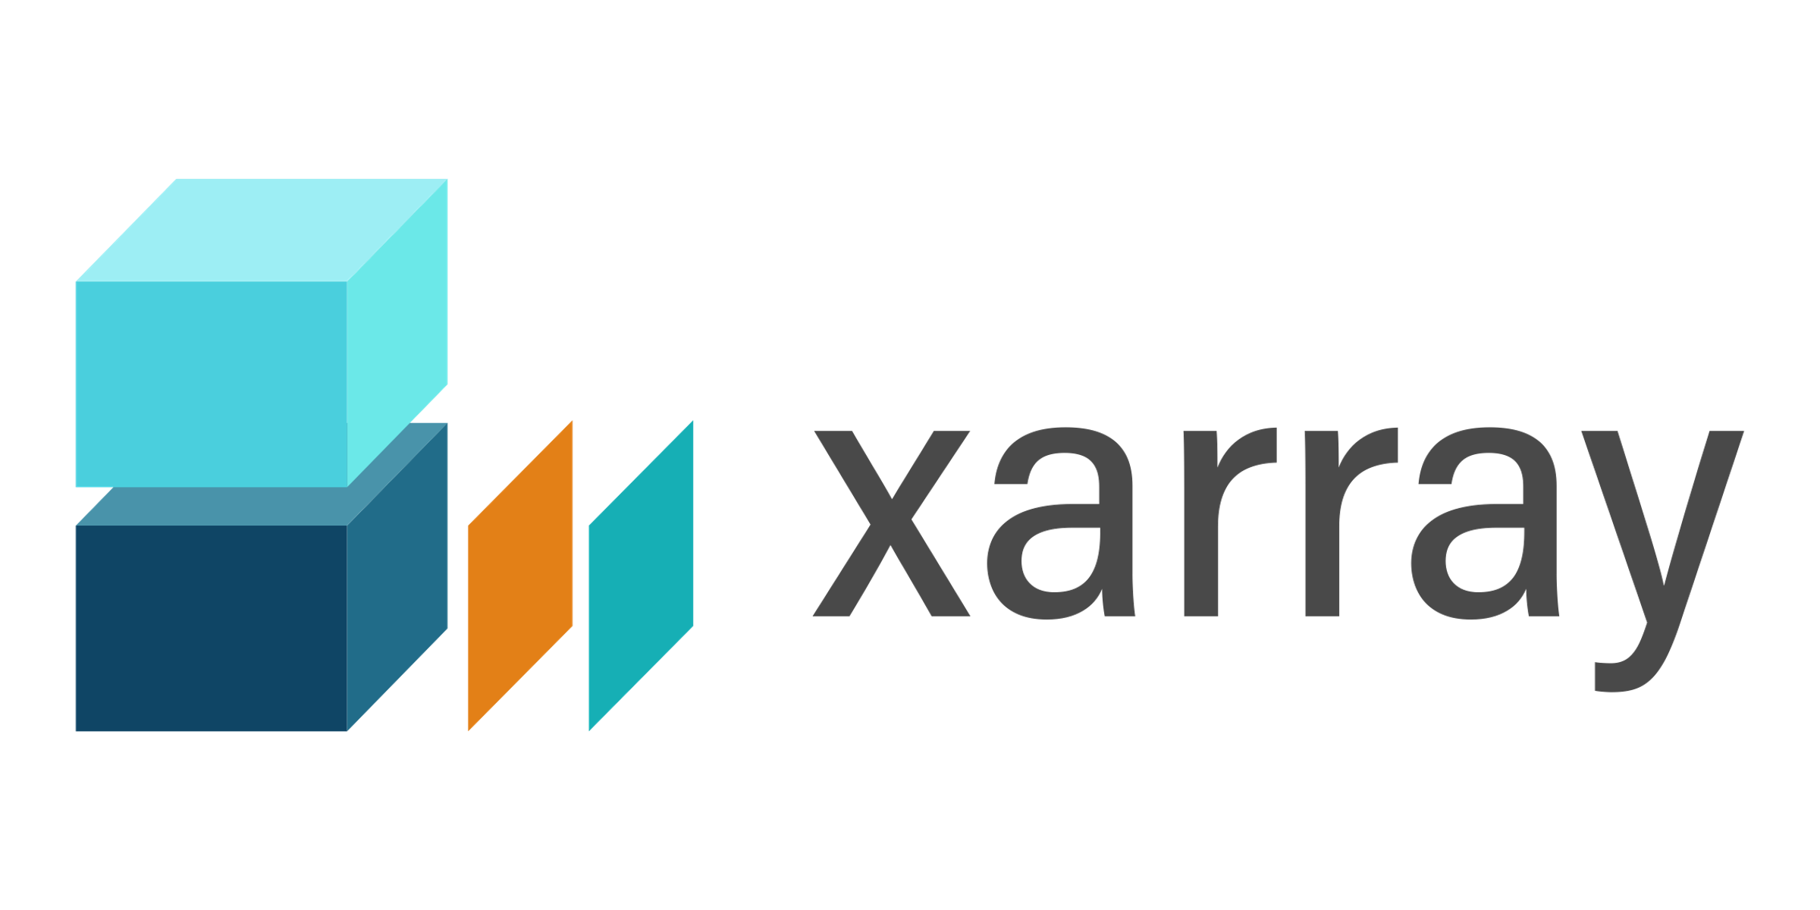


Python – Virtual Environments
Depends on
Depends on
Version >= 1.22.4
Version >= 1.23
Dedicated environment for specific applications with according software and versions
Isolation of dependencies: different projects require different software in different versions (...with dependencies in different versions)
Reproducibility: configured environments can be saved and restored
Stability: changes to one project/environment do not affect others
Collaboration: everyone in the project uses the same environment, same software, same versions

Slide 11
Python – Virtual Environments
Operating System (OS)
System-native global Python Installation Python 3.7 C:\Users\<User>\AppData\ Local\Programs\Python\...
…with all installed packages (e.g.. Package A, B, … ,F)

Slide 12
Python – Virtual Environments
Operating System (OS)
Available Python e.g. in terminal, IDE “python hello_world.py”
System-native global Python Installation Python 3.7 C:\Users\<User>\AppData\ Local\Programs\Python\...
…with all installed packages (e.g.. Package A, B, … ,F)

Slide 13

Python – Virtual Environments
Operating System (OS)
Available Python e.g. in terminal, IDE “python hello_world.py”
System-native global Python Installation Python 3.7 C:\Users\<User>\AppData\ Local\Programs\Python\...
…with all installed packages (e.g.. Package A, B, … ,F)
Conda Installation C:\Users\<User>\AppData\Local\miniconda3
…\pkgs (all installed packages)
…\envs (alle created virtual environments)

Slide 14
Python – Virtual Environments
Operating System (OS)
Available Python e.g. in terminal, IDE “python hello_world.py”
System-native global Python Installation Python 3.7 C:\Users\<User>\AppData\ Local\Programs\Python\...
…with all installed packages (e.g.. Package A, B, … ,F)
Conda Installation C:\Users\<User>\AppData\Local\miniconda3
…\pkgs (all installed packages)
…\envs (alle created virtual environments)
“virt-env1”
…\envs\virt-env1
Python 3.12
Used packages:
A
B
C
“virt-env2”
…\envs\virt-env2
Python 3.9
Used packages:
B
C
D
“virt-env3”
…\envs\virt-env3
Python 3.11
Used packages:
D
F

Slide 15
Python – Virtual Environments
Operating System (OS)
Available Python e.g. in terminal, IDE “python hello_world.py”
System-native global Python Installation Python 3.7 C:\Users\<User>\AppData\ Local\Programs\Python\...
…with all installed packages (e.g.. Package A, B, … ,F)
Conda Installation C:\Users\<User>\AppData\Local\miniconda3
…\pkgs (all installed packages)
…\envs (alle created virtual environments)
“virt-env1”
…\envs\virt-env1
Python 3.12
Used packages:
A
B
C
“virt-env2”
…\envs\virt-env2
Python 3.9
Used packages:
B
C
D
“virt-env3”
…\envs\virt-env3
Python 3.11
Used packages:
D
F

Slide 16
Python – Virtual Environments
Operating System (OS)
Available Python e.g. in terminal, IDE “python hello_world.py”
System-native global Python Installation Python 3.7 C:\Users\<User>\AppData\ Local\Programs\Python\...
…with all installed packages (e.g.. Package A, B, … ,F)
Conda Installation C:\Users\<User>\AppData\Local\miniconda3
…\pkgs (all installed packages)
…\envs (alle created virtual environments)
“virt-env1”
…\envs\virt-env1
Python 3.12
Used packages:
A
B
C
“virt-env2”
…\envs\virt-env2
Python 3.9
Used packages:
B
C
D
“virt-env3”
…\envs\virt-env3
Python 3.11
Used packages:
D
F

Slide 17

Python – Virtual Environments Interactions with your computer and the internet
Internet
Conda Channels
Python Package Index
Your computer / Operating System (OS)
Local File System
HomeDir
- Desktop
- Documents
- Downloads - conda-env.yml - notebooks - notebook1.ipynb - notebook2.ipynb - notebook3.ipynb - ...
Conda activates / deactivates “env-1”
Conda downloads Python modules (libraries, dependencies) and installs / updates them in “env-1”
Conda uses conda-env.yml to create / update “env-1”
“env-1”
“env-1” has access to the file system, e.g. read / write files e.g. open notebooks in Jupyter Lab
Within “env-1”, installed Python and libraries can be used e.g. import pandas in code, e.g. start Jupyter Lab

Slide 18
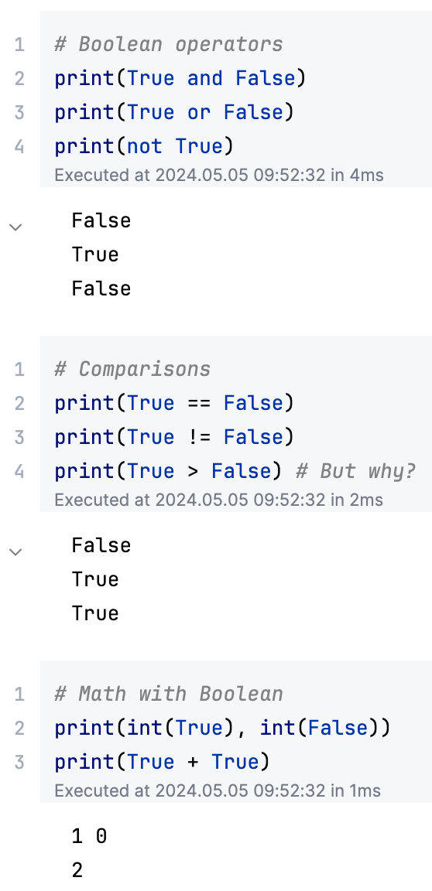
Python - Built-in types Truth and Boolean
Truth value and Boolean
Objects can be tested for a truth value
Truth values can be used in conditions
Represented by Booleans: True (1) and False (0)
There are default truth values for objects, e.g., number zero or empty strings are considered False
Boolean operators and comparisons
Used to evaluate a truth value
Operators are and, or, not
Comparisons are, e.g., < (strictly less), == (equal), >= (greater than or equal), != (not equal)

Slide 19
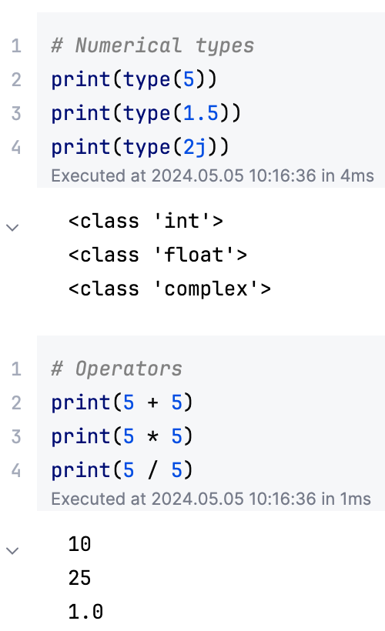
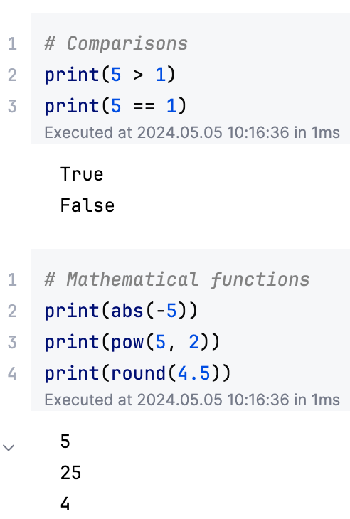
Python - Built-in types Numeric types
Numeric types
Integers (int)
Floating point numbers (float)
Complex numbers (complex)
Supported operations
Mathematical operators, e.g., +, -, /
Comparisons
Mathematical functions
Some may behave unexpected!

Slide 20
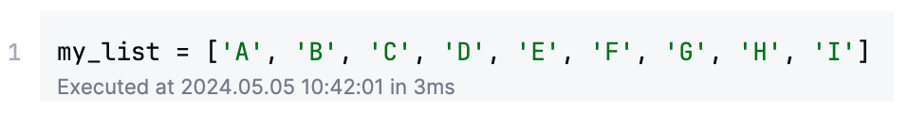
Python - Built-in types Sequence types
Some basics on sequences
Data structures to store and manipulate multiple values
Values can be of homogeneous or heterogeneous type
Sequences are either mutable (values can be changed “in place”) or immutable
Values can be accessed by an index on the sequence, starting at 0
Index
0 | 1 | 2 | 4 | 5 | 6 | 7 | 8 | 9
A | B | C | D | E | F | G | H | I
Values

Slide 21
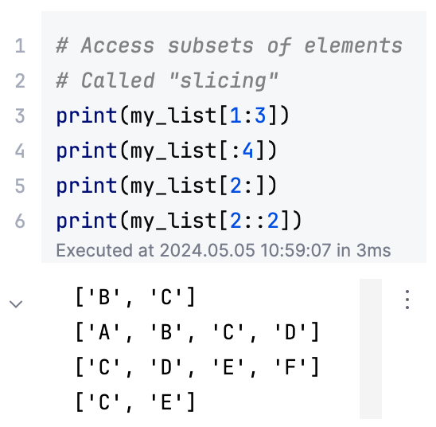
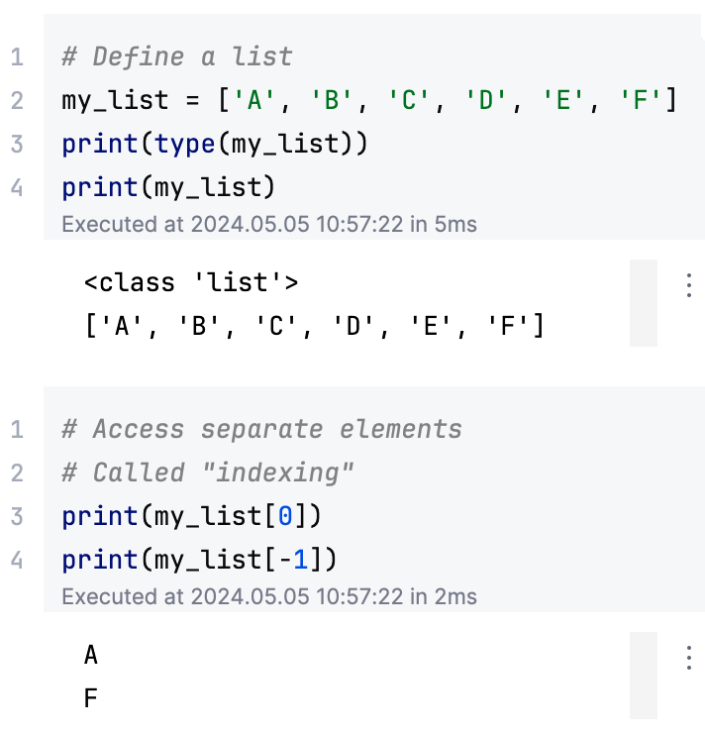
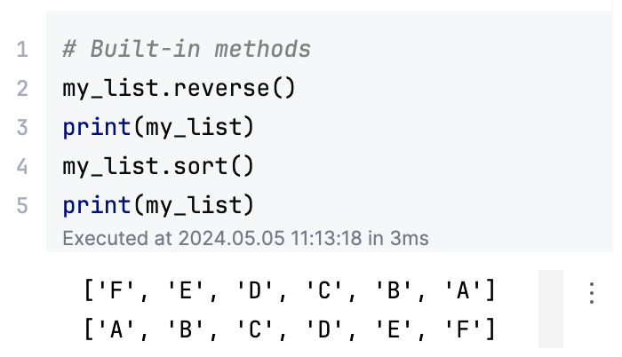
Python - Built-in types Sequence types
Get elements from index 1 to 2
Lists
Mutable, construction via brackets [ ]
Homogenous or heterogenous values
Get all elements up to index 3
Get all elements starting at index 2
Get every second element, start at index 2
Call built-in method to reverse the list
Use negative index to start at the last element

Slide 22
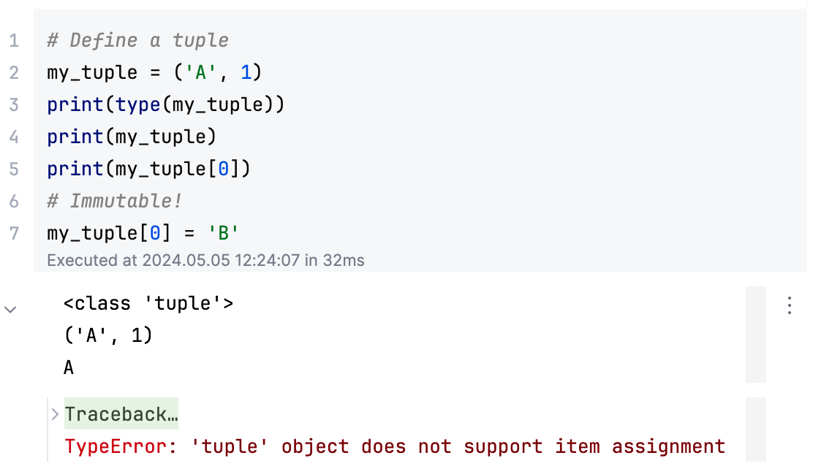
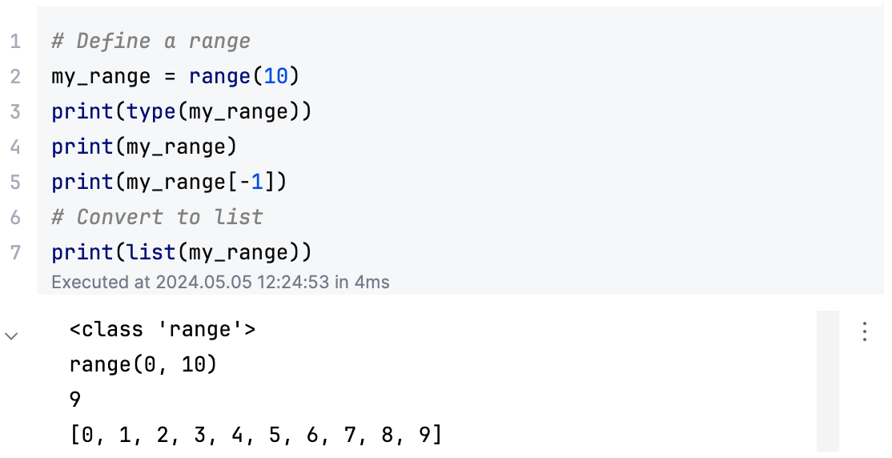
Python - Built-in types Sequence types
Tuples
Immutable, construction via parentheses ( )
Homogenous or heterogenous values
Indexing and slicing works like for lists
Ranges
Immutable, construction via range( )
Homogenous numerical values
Indexing and slicing works like for lists

Slide 23
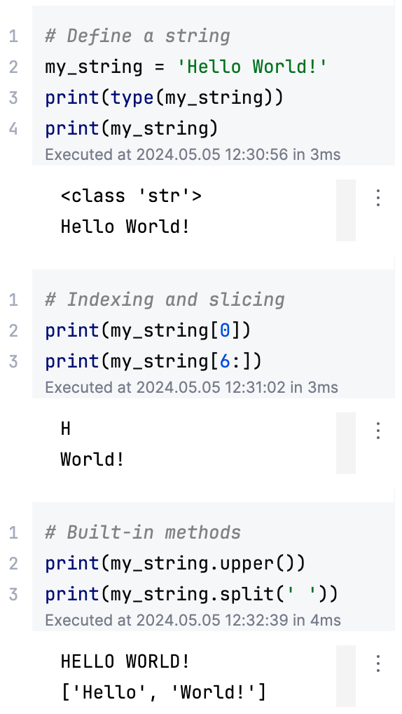
Python - Built-in types Sequence types
Text sequence - string
Immutable, construction via quotes “ “, ‘ ‘
Values of type Unicode codepoints
Indexing and slicing works like for lists
Convert all letters to uppercase
Split the string at whitespace and return a list of resulting strings

Slide 24
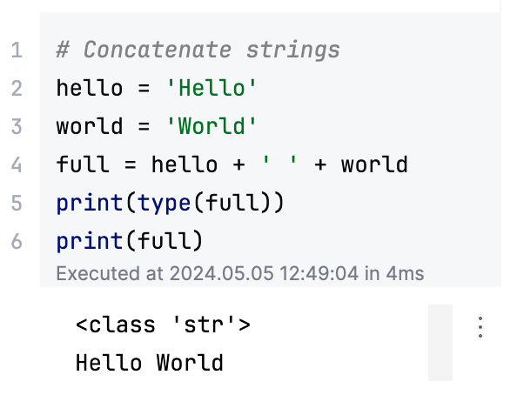
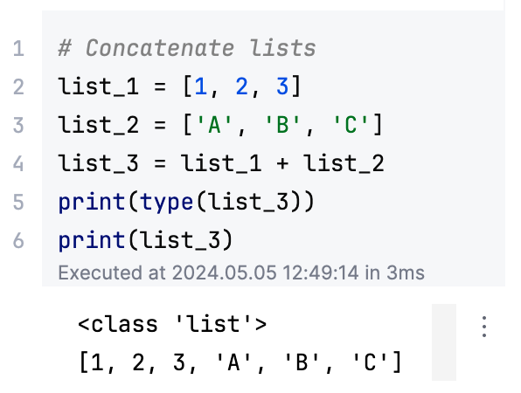
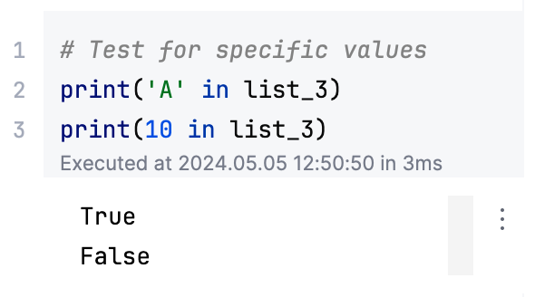
Python - Built-in types Sequence types
Further operations on sequences
Sequences can be concatenated (append them) with + operator
Sequences can be tested for their content with in

Slide 25
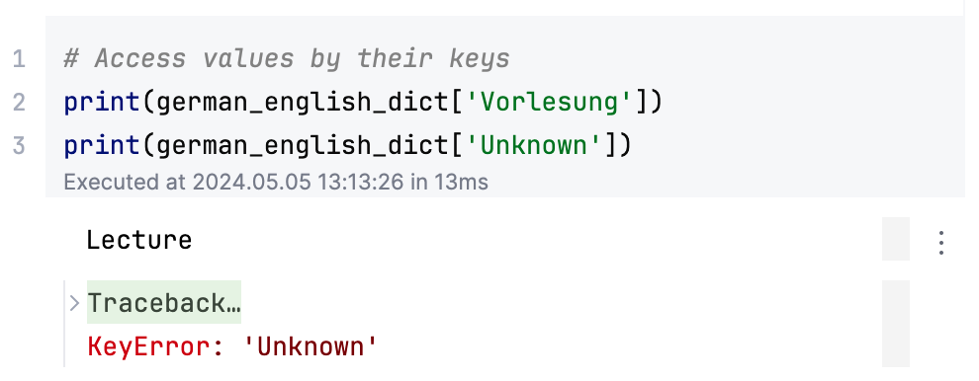
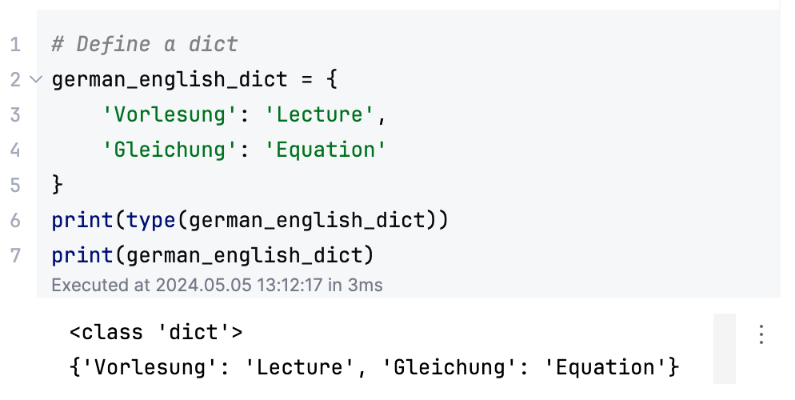
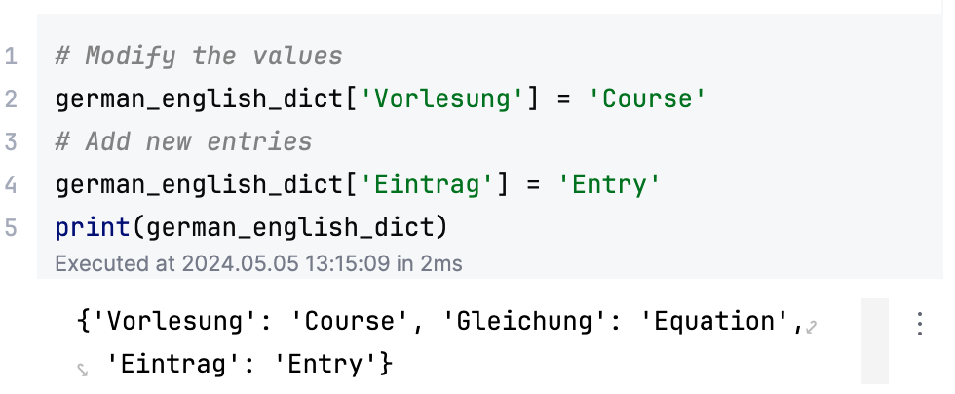
Python - Built-in types Dictionaries
Mapping types or dictionaries (dicts)
Mutable, construction via braces { }
Provide a mapping from key → value, i.e. a list of key → value pairs
Indexing and slicing works NOT like for lists

Slide 26
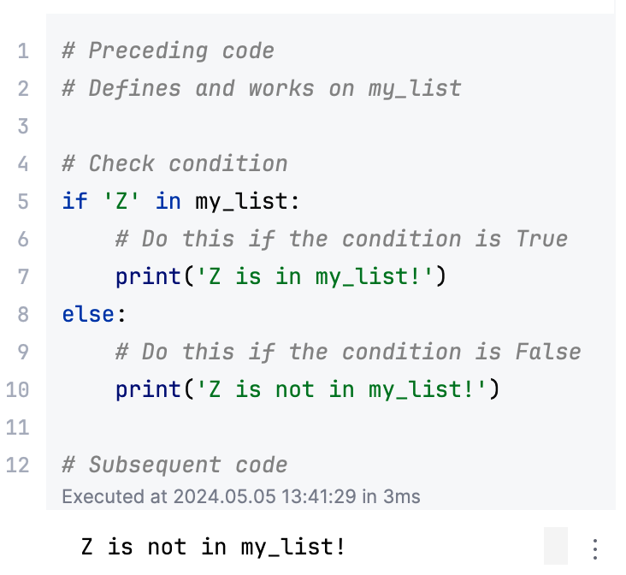
Python - Conditions
Conditional statements
Used as control flow tool, e.g., to check
if pre-requisites are met
if data has the right format or value
if there are any errors
The if statement is used to
Evaluate a Truth value for given expressions, e.g., with Boolean operators of comparisons
Executes subsequent code if the Truth value evaluates to True
The else statement can be used to execute code if the given expressions evaluate to False
True
?
False

Slide 27
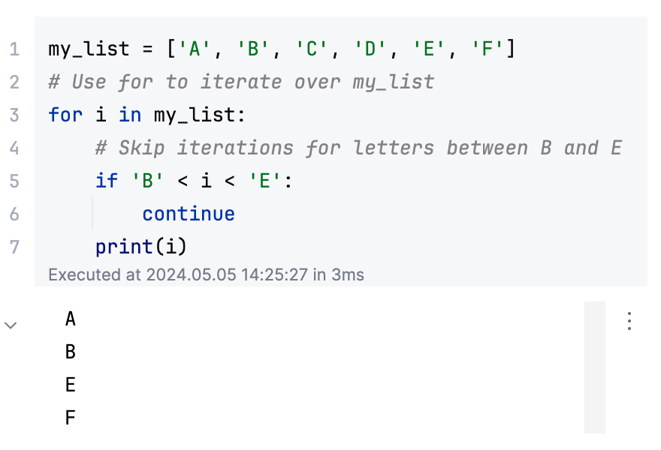
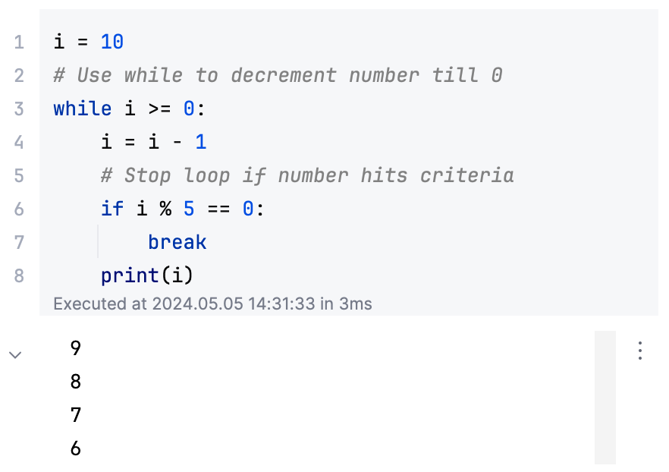
Python - Loops
Loop statements
Used as control flow tool for repeated execution of code
Different kinds of loop statements
for: iterates over elements of a sequence (e.g. list), or iterable objects in general
while: repeats subsequent code as long an expression is True
Both can be controlled in more detail using
break to terminate the loop
continue to skip the current iteration

Slide 28
Any questions or remarks?
Let’s practice – Python Basics in Jupyter Lab

